Slide 1
DELTATEE
INNOVATIONS
Innovative Solutions
for the
21st Century

Slide 2
What is Wireless Wire?
The Wireless Wire is a low cost, low power, wireless mesh RF communications platform which allows the user to achieve greater distances and reliable communications between devices.
The Wireless Wire is able to achieve these benefits by using the Zigbee RF technology which is intended for low data rate and long battery life, while ensuring there is secure networking communications.

Slide 3
Rapid Return on Investment
By using the Wireless Wire, traditional copper wire use is eliminated.
Setup is quick and easy.
No radio specialists, or site planning /mapping required.
Devices can be added later and the Wireless Wire will automatically incorporate that into the mesh network and will determine the best signal path.
Many types of input/output available including: Switches & industrial automation networking communication protocols.

Slide 4
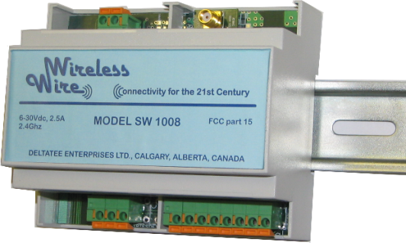
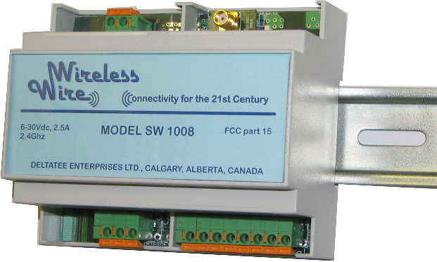
WIRELESS CONNECTIVITY
Switches & Outputs
BASE UNIT
Connect
INPUTS : 8 or 16 Dry Contacts
OUTPUTS : 8 or 16 Open Collector to Gnd. 50V , 2A
Switches & Outputs

Slide 5
WIRELESS CONNECTIVITY
4-20mA
Analog Out
ANALOG OPTION
INPUTS : 4 x 4-20mA
OUTPUTS : 2 x 4-20mA
Connect
4-20mA
Analog In

Slide 6
WIRELESS CONNECTIVITY
Serial Port
SERIAL OPTIONS
Connect
INPUTS : 2 x RS232 or 1 x RS485 or 1 x USB Peripheral
OUTPUTS : 2 x RS232 or 1 x RS485 or 1 x USB Device
Serial Port

Slide 7
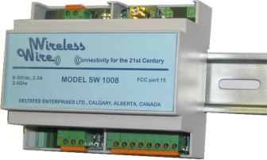
WIRELESS CONNECTIVITY
MULTIPLE UNITS
UPTO 32 UNITS
Connect
Connect
Connect
Connect
Connect
SELF-CONFIGURING

Slide 8
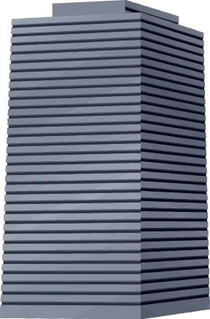
WIRELESS CONNECTIVITY
MULTIPLE UNITS
UPTO 32 UNITS
Connect
Connect
Connect
Connect
Connect
SELF-HEALING
MESH NETWORK
Connect
Obstacle
Connect

Slide 9
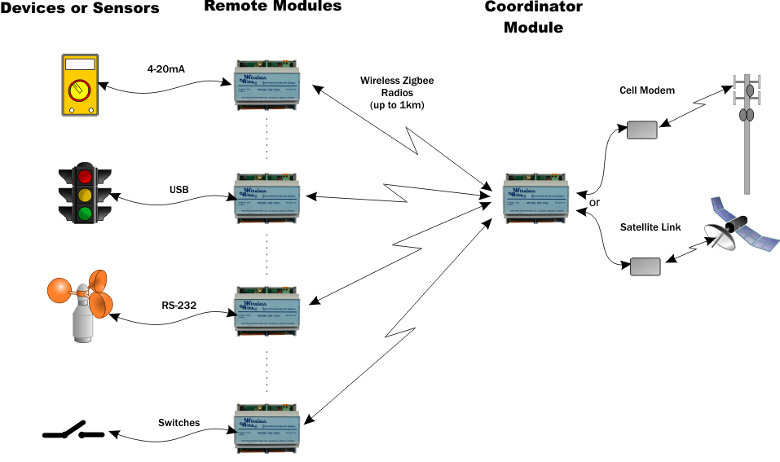
MIX AND MATCH

Slide 10
FEATURES
Replaces traditional copper wire cost effectively:
Compared to the cost of equipment, labor and specialized knowledge that is required to install point-to-point copper wiring and conduit, Wireless Wire is much less expensive.
Rapid deployment:
The Wireless Wire is simple. The control system does not know that copper has been replaced with a Wireless Cable link, but the Wireless Cable network is inherently more reliable, more adaptable, and scalable.
Radio mesh network system:
The Wireless Wire is self-configuring, and does not require a network or radio specialist. The Wireless Wire is adaptable. It has the ability to self-heal the network.

Slide 11
DELTATEE
INNOVATIONS
www.wirelesswire.ca

